Slide 1
Leveraging Deep Learning and Large Language Models to Identify Clinical Exposure Changes Due to Extrinsic and Intrinsic Factors
Hamed Meshkin
DARS Division Meeting
April 10, 2025
Notes:
Hi everyone! The presentation I’ll be sharing is titled 'Leveraging Deep Learning and Large Language Models to Identify Clinical Exposure Changes Due to Extrinsic and Intrinsic Factors.’ If you happened to catch my talk during the recent Lunch and Learn seminar, some of this might look familiar—but, today’s version goes a bit further, as we’ve explored additional large language model and incorporated new insights that I’m excited to walk you through. In this talk, we will explore how advanced Natural Language Processing techniques powered by large language models can simplify and enhance regulatory workflows.
Beside that this study emphasizes how these models can be securely deployed in local environments to perform critical tasks, such as analyzing FDA drug labels to identify pharmacokinetic drug-drug interactions.

Slide 2
Outline
Prior Study (Fine-tuning LLM to extract clin pharm information with custom training dataset)
Objective
Background and Motivation (Extracting drug-drug Interaction + object and precipitant drug)
BioBert Directional DDI model
Result and Performance
Second Study (Directly Using LLM to extract clin pharm information with Few/zero training)
Objective
Background (Extracting drug-drug Interaction + patients' intrinsic factors)
LLM In-context learning (Few and Zero-shot learning)
Model Evaluation
Summary
Notes:
I’ll begin with our first Study, which we worked on fine-tuning large language models to extract clinical pharmacology data. I’ll cover:
The study’s goal.
Background, including the need to extract drug-drug interactions and roles of object/precipitant drugs.
Development and fine-tuning of the BioBERT Directional DDI model.
Results and performance review.
Next, we’ll discuss the Second Study, which explores using LLMs for extracting clinical pharmacology data with minimal training, leveraging few-shot and zero-shot learning. This section will include:
The study’s objective.
Challenges in this task.
In-context learning with LLMs.
Model evaluation.

Slide 3
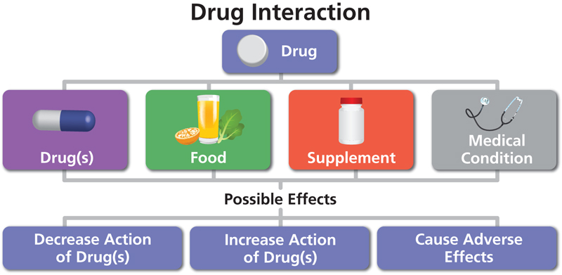
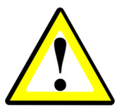
1. Goal (prior): Fine-tuning LLM to extract clin pharm information using custom dataset
Extract critical biomedical data, including pharmacokinetic drug-drug interactions, object and precipitant drugs, from literature.
Automatically Extract directional drug–drug interaction (DDI) from the natural text to identify the change in one drug’s clinical exposure due to the pharmacokinetic DDI of other drugs
Task 1
Task 2
“The mean values of Cmax and AUC of nifedipine are increased by 64% and 79%, respectively, by co-administration of propranolol [1]
Object?
propranolol is precipitant and nifedipine is the object drug
“Verapamil therapy may increase serum levels of cyclosporine.” [1]
Verapamil is precipitant and Cyclosporine is the object drug
Precipitant?
[1] https://dailymed.nlm.nih.gov/dailymed/fda
Notes:
Our first study aimed to develop a fine-tuned large language model capable of extracting clinical pharmacology information from biomedical text, including critical data from drug labels and biomedical literature. Specifically, we focused on pharmacokinetic drug-drug interactions (PK-DDIs), which are essential for understanding how one drug influences another's clinical exposure.[]
Consider a scenario where one drug unexpectedly reduces the effectiveness of another drug.[] So there is a directional relationship between these two drugs that can be crucial, as it can lead to serious, even life-threatening, consequences.[]
Our model was designed to perform two key tasks: identifying sentences that describe DDIs and distinguishing the roles of the drugs involved.
It classifies the 'object drug,' whose exposure is altered, and the 'precipitant drug,' which causes the change.
For example, there are two sentence:
The mean values of Cmax and AUC of nifedipine are increased by 64% and 79%, respectively, by co-administration of propranolol .
Verapamil therapy may increase serum levels of cyclosporine.
Accurately extracting and classifying this information is essential for optimizing therapeutic decisions, preventing adverse drug interactions, and accelerating the drug development process.

Slide 4
Introduction (prior)
Two-Step NLP Pipeline for Pharmacokinetic DDIs
Natural language processing (NLP) methods to automatically extract and process information from biomedical literature
Task 1: RE
Relationship Extract (RE)
NLP Model to identify PK DDI sentences
Pharmacokinetic drug-drug interaction sentences (PK-DDI)
Biomedical literature corpus
PK DDI
No Pharmacokinetic drug-drug interaction sentences (Non PK-DDI)
Task 2: NER
Name Entry Recognition (NER)
NLP Model to identify Precipitant and object drugs
Pharmacokinetic drug-drug interaction sentences (PK-DDI)
Precipitant drug
Object drug
1) Traditional Neural Network models
2) Pre-trained large Language models
Notes:
The primary objective of our first task is to determine whether a sentence describes a pharmacokinetic drug-drug interaction (PK-DDI) or a non-PK-DDI interaction. [] This process, known as Relationship Extraction (RE), involves training an NLP model using a biomedical literature corpus to automatically classify sentences into these categories. []
The second task focuses on Named Entity Recognition (NER). Once a sentence is identified as describing a PK-DDI, we further analyze it to determine which drug got affected ('object) and which drug causing the effect (precipitant.)
This slide illustrates how the two tasks work together: first, the RE model classifies sentences as PK-DDI or non-PK-DDI. Then, the NER model identifies the relevant drugs in PK-DDI sentences and assigns roles to them accordingly. []
Overall to have these models, we can choose between two approaches:
Traditional machine learning methods.
Advanced pre-trained large language models, which leverage state-of-the-art capabilities for improved accuracy and efficiency.

Slide 5
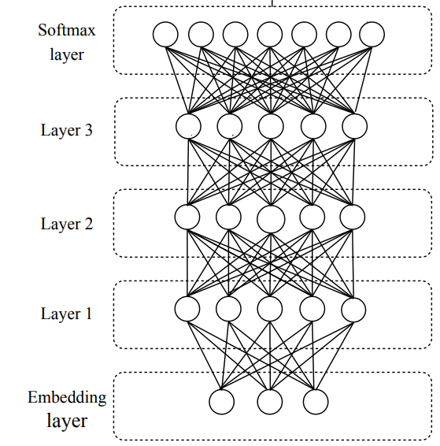
Background
Traditional NLP vs Pre-trained Language Models
1) Traditional Neural Network Models
Disadvantages
Training is slow and computationally expensive.
Long sequences cause vanishing gradients, leading to loss of word relationships
Fine-tune an LLM model
Pre-trained models drastically reduce training time.
Identify relationships between the elements using Attention Mechanism
Advantages
2) Pre-trained large language model
In-context learning
(Zero or few-shot learning)
Notes:
Traditional Machine Learning involves training models using labeled data, where the model learns relationships between words. However, it faces significant challenges:
Slow Training: Training traditional models demands large datasets and extensive computational resources, leading to a time-consuming and inefficient process.
Vanishing Gradient Problem: Traditional neural networks struggle with long sequences, often losing the relationship between distant words. For instance, in a lengthy sentence, the connection between the first and last words may be lost, reduces the model's ability to capture context accurately. []
Pre-trained Transformer-Based large language model are already Pre-trained drastically reduce training time. They also take advantage of a strategic term, named “Attention Mechanism” which force the model to read and answer only the specific information you need
Therefore, pre-trained transformer models can understand complex language structures. And they offer two flexible options:
Fine-tuning: Even with a pre-trained model, we can fine-tune its parameters for specific tasks. This process is similar to training but far quicker and more efficient, as the model already understands language patterns.
In-context learning models, we can leverage their ability to perform tasks with minimal or no additional training, making them even more efficient.
So, Transformer-based Large Language Models offer clear advantages over traditional neural networks, enabling faster training, improved efficiency, even in long sequences.

Slide 6
1. Methodology (Prior) BioBert Fine-tuning Models
BioBERT = Pre-trained BERT + Additional pre-training on biomedical data
BioBert model pre-trained with PubMed
Bert
325 structured product tables
(Pre-specified by TAC2019)
PubMed abstracts
PMC full-text articles
21593 annotated sentences
Fine-Tuning
Model Training
13B words
BioBert Directional DDI model¹
BioBert 340M parameters
81 structured Product labels
(Pre-specified by TAC2019)
10592 unannotated sentences
Predict precipitant and object drugs in pharmacokinetic DDIs
Model Validation
Relationship Extract (RE)
Named Entry Recognition (NER)
QA
Evaluate Performance
Zirkle, Joel, et al. "Deep learning-enabled natural language processing to identify directional pharmacokinetic drug–drug interactions." BMC bioinformatics 24.1 (2023): 413.
Notes:
This slide outlines the key work accomplished in our previous project, which centered on fine-tuning a pre-trained BioBERT model for extracting pharmacokinetic drug-drug interactions (PK-DDIs).
BioBERT, a language model trained on 13 billion words from PubMed abstracts and PMC full-text articles, contains 340 million parameters.
This model is ideal for tasks like Relationship Extraction, named entity recognition, and even question answering tasks. In this project, we customized BioBERT to identify PK-DDI sentences and classify the roles of object drugs and precipitant drugs. []
The diagram illustrates the two main stages of this process:
First Fine-Tuning: We fine-tuned the pre-trained BioBERT model using approximately 21 thousand annotated sentences from the FDA’s TAC2019 dataset. This resulted in the BioBERT model which we named it as BioBERT Directional DDI model, specifically optimized for PK-DDI extraction.
Second is Model Validation: The fine-tuned model was tested and validated using 10 thousand unannotated sentence again from TAC2019.

Slide 7
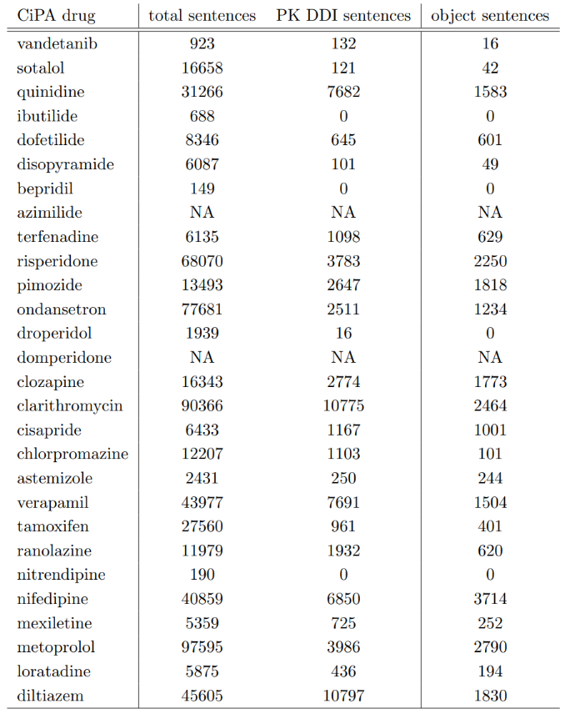
Result (Prior)
BioBert Directional DDI Model (fine-tuned BioBERT)
1st task: PK-DDI Identification Task
Real world problem
From a list of 28 drugs from the Comprehensive in vitro Proarrhythmia Assay (CiPA) Initiative.
Recall | 80.6 %
Precision | 82.7%
F-score | 81.6%
Performance of the sentence classification step.
2nd task: Identifying Object and Precipitant drugs in PK DDI sentences
 | Object | Precipitant
Recall | 93.7% | 94.6%
Precision | 100% | 100%
F-score | 96.8% | 97.2%
Performance of the named entity recognition step
Zirkle, Joel, et al. "Deep learning-enabled natural language processing to identify directional pharmacokinetic drug–drug interactions." BMC bioinformatics 24.1 (2023): 413.
Notes:
To evaluate the model’s performance, we relied on key validation metrics: recall, precision, and F-score. High values across these metrics—ideally close to 100%—reflect the model’s robustness and accuracy in prediction. For the first task, identifying PK-DDI sentences, the model demonstrated strong performance with precision, recall, and F-scores all exceeding 80%. [] In the second task, which focused on identifying object and precipitant drugs within PK-DDI sentences:
The model evaluation metrics achieved above 90% for both object and precipitant drugs []
In a further analysis, the BioBERT Directional DDI model was applied to analyze sentences from FDA drug labels as part of the Comprehensive in vitro Proarrhythmia Assay (CiPA) initiative.
The first column lists the drug names.
The second column indicates the total number of sentences extracted per drug, totaling approximately 46,000 across all labels.
The third column shows the number of PK-DDI sentences identified for each drug.
The fourth column highlights the frequency with which each drug was identified as an object drug means having its pharmacokinetics altered by the presence of other drugs.
So, these metrics demonstrate the high reliability of the fine-tuned BioBERT model for automatically extracting directional pharmacokinetic drug-drug interaction information from biomedical text.

Slide 8
2. Second study
Using LLM to extract clin pharm information with few/zero
Objective: Fine-tuning a pre-trained model for a new task is impossible unless we acquire an annotated dataset containing positive and negative examples related to the specific task.
Goal:
Extract critical biomedical data, such as pharmacokinetic drug-drug interactions, precipitant -object drug, and intrinsic factors and so on, from literature using locally hosted Large Language Models (LLMs).
Ensure data privacy to Implement secure locally hosted Large Language Models.
Notes:
In the second study, we focused on extracting clinical pharmacology information using advanced transformer-based large language models (LLMs) with minimal or no additional training.
The key objective was to overcome a significant limitation of models like BioBERT, which require fine-tuning for every new task. Fine-tuning needs a large, annotated dataset—a resource that can be challenging and time-consuming to create,
To address this, our goal was to implement open-source LLMs within a secure local environment, enabling these models to perform diverse natural language processing tasks without needing extensive training data. it has two benefits
first Efficient Extraction of Biomedical Data: These models can extract critical biomedical information—such as pharmacokinetic interactions, object and precipitant drugs, or patients’ intrinsic factors—from unstructured biomedical text using in-context learning. This approach eliminates the need for labeled training data and allows quick adaptation to various tasks without relying on large task-specific datasets.
Second Data Privacy and Regulatory Compliance: Implementing these models in secure environments ensures data privacy and compliance with regulatory standards. While online chatbot sources like ChatGPT can be used for certain purposes, they cause a risk of data leakage when handling sensitive information.
Overall, This approach not only simplifies task execution but also addresses key challenges associated with data availability and compliance in sensitive biomedical domains.

Slide 9


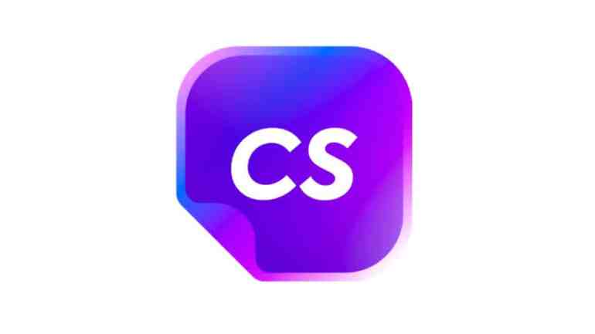




2. Objectives Pre-trained Transformer-based Large Language Model
Google Gemini
Chat Sonic
ChatGPT
Claude
Jasper AI
Perplexity AI
Objectives
One can use our previous technique, HOWEVER, for any task we need to prepare sufficiently large training/validation dataset and consequently fine-tun the model
One can use one of these online sources, HOWEVER, there is a risk of data leakage associated with the utilization of online platforms
Implement secure, locally hosted Large Language Models to automate extraction and classification of interaction data while ensuring data privacy

Slide 10


2. In-context learning
Few/Zero shot training
Few Shot Learning
Large data collection
Example 1: PK DDI sentence Example 2: PK DDI sentence
Example 3: Non-PK DDI sentence Example 4: Non-PK DDI sentence
+
Prompt + (sentences set)
FSL input
Query set Prediction
Pre-processing
Model Inference
Tokenization
Post-Processing
Few-shot learning (FSL) practice of feeding a machine learning model with a very small amount of training data to guide its predictions
Notes:
This slide illustrates the workflow of a transformer-based large language model in the concept of in-context learning. While these models are typically pre-trained, additional learning can happen through approaches like few-shot or zero-shot learning.
For Few-shot learning we introduce a small amount of labeled training data to guide the model's predictions.
For our case, we fed our LLM with 4 labeled sentences: two describing pharmacokinetic drug-drug interactions as pk-DDI and two describing non-PK DDI sentences. These examples, along with validation sentences, are provided in the form of a prompt question to the model.
Before the model can make predictions, the input data undergoes several key preprocessing steps:
Pre-processing and tokenization: The input sentences and the prompt are tokenized and encoded, converting them into a numerical format suitable for the model.
Model Inference: The encoded input is processed by the LLM to generate predictions.
Post-processing: The output is decoded to determine whether the provided sentence can be understand by human.

Slide 11
2. In-context learning
Zero/Few shot training
Large data collection
Zero Shot Learning
Prompt + (sentences set)
ZSL input
Query set Prediction
Pre-processing
Model Inference
Tokenization
Post-Processing
Zero-shot learning (ZSL) is a Machine Learning paradigm that introduces the idea of Query samples with class labels that were never observed during the initial training phase
Notes:
In zero-shot learning, unlike few-shot learning, the model makes predictions without any labeled examples for the specific task. Instead, it relies entirely on its pre-trained knowledge and the provided prompt query.
However, the model processing is the same : Zero-shot learning contain pre-processing, tokenization and post-processing.
These capability as Few shot or zero shot learning allows the model to generalize to new tasks without requiring additional fine-tuning or labeled data.[]

Slide 12

2. Comparison
Pre-trained Large Language Transformer Models
Model | Parameter size
Flan-T5-XXL | 11B
Tk-Instruct | 11B
T0pp | 11B
Vicuna | 13.7B
ChatGPT3 | 175B
BioBERT | 0.34B
Flan-T5-XXL
Tk-instruct
T0PP
Vicuna
BioBert
Large language transformer Models
Hugging Face
Notes:
For our purpose we employed 6 pre-trained transformer models that we used during our validation process
FLAN-T5-XXL
Tk-Instruct
T0pp
Vicuna
BioBERT
To benchmark which models are suitable for extracting clinical pharmacology information, we also included DeepSeek. This model has recently attracted significant attention due to its open-source availability and the relatively low cost of training compared to industry-leading LLMs.
These models are all accessible through the Hugging Face platform, which provides a centralized repository for a wide variety of pre-trained models
We can compare these LLMs based on the parameter size
For example:
BioBERT, which has 340 million parameters, is the smallest model listed here which explaines why often requires fine-tuning to improve its performance On the other hand, we have Vicuna with 13.7 Billion parameters. And DeepSeek V2 largest model on this list with 32Billion parameters.

Slide 13
2. Prompt
Pharmacokinetic Drug-Drug Interaction
Model | Task 1: Identifying PK DDI sentences
Flan-T5 | Is it true that this sentence relates to how the pharmacokinetics of one drug, namely absorption, distribution, metabolism, or excretion, change when co-administered with another drug, indicating a pharmacokinetic drug-drug interaction? “The co-administration of AFINITOR with long-acting octreotide increased octreotide C_{min} by approximately 50%.” Options: -Yes -No
Tk-instruct | In this task, you are given two sentences. Indicate if the first sentence clearly entails the second sentence (i.e., one can conclude the 2nd sentence by reading the 1st one). Indicate your answer with 1 if the first sentence entails the second sentence, otherwise answer with 0. Sentence 1: The coadministration of AFINITOR with long-acting octreotide increased octreotide C_{min} by approximately 50%.”. Sentence 2: The sentence is about pharmacokinetic drug-drug interaction which relates to how the pharmacokinetics of a drug, namely absorption, distribution, metabolism, or excretion, change when co-administered with another drug Output.
T0pp | The following sentence relates to how the pharmacokinetics of a drug, namely absorption, distribution, metabolism, or excretion, change when co-administered with another drug, indicating pharmacokinetic drug-drug interaction. “The co-administration of AFINITOR with long-acting octreotide increased octreotide C_{min} by approximately 50%.” True, or False?
Vicuna | Given “The co-administration of AFINITOR with long-acting octreotide increased octreotide C_{min} by approximately 50%.” Is it true that this sentence relates to how the pharmacokinetics of a drug, namely absorption, distribution, metabolism, or excretion, change when co-administered with another drug, indicating a pharmacokinetic drug-drug interaction? exclusively answer with Yes or No.
Performance significantly declines if the task is not clearly and accurately described to the model.
The co-administration of AFINITOR with long-acting octreotide increased octreotide Cmin by approximately 50% This sentence suggests a Pharmacokinetic drug-drug interaction. is this true?
Yes, or no?
Notes:
This slide presents the prompts we used for evaluating each large language
What you see here are the prompts fed into different models. we applied a unique prompt format for each model in order to get the best performance from each model.
Blue text are the sentences extracted directly from FDA labels.
Red text represents the prompt question given to the model.
Let’s take the first example with Flan-T5:
The sentence extracted from the drug label is: “The co-administration of AFINITOR with long-acting octreotide increased octreotide Cmin by approximately 50%.”
The prompt asks the model: “Is it true that this sentence relates to how the pharmacokinetics of one drug, namely absorption, distribution, metabolism, or excretion, change when co-administered with another drug?”
Yes or no? []
We also fed the model with multiple different prompt as it shows on the right side the first prompt we start with for this task, and we got a very poor performance
The prompt question is “This sentence suggests a Pharmacokinetic drug-drug interaction. is this true?”
the performance of models like Flan-T5 can decline if the task is not described clearly or the prompt does not align well with the model's training.
So, Properly framing the task ensures the model understands the context and delivers accurate results.

Slide 14
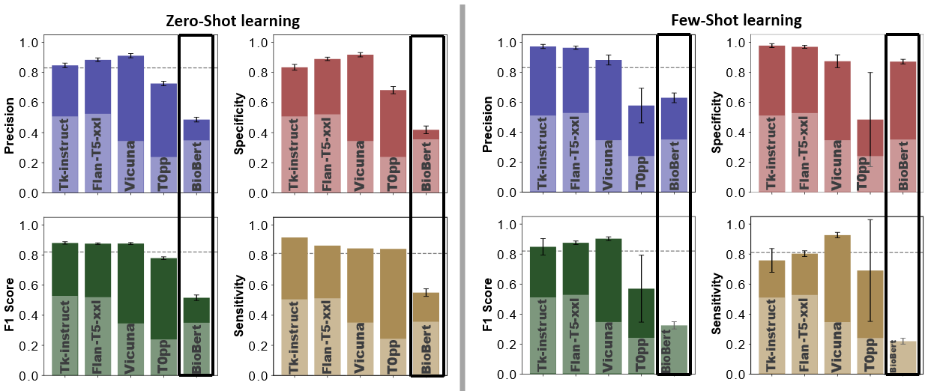
2. Model Evaluation
Validate LLMs performance by identifying PK-DDI sentences
Zero / Few-shot learning evaluated by 10242 (PK and Non-Pk DDI) sentences
Fine-tuned BioBERT
Notes:
Here we, summarizes the PK-DDI evaluation results by comparing the performance of different models, including our fine-tuned BioBERT model from the prior research
we have the evaluation result For our selected large language model, each bar represents a different model, and each color corresponds to the specified evaluation metrics for zero-shot and few-shot learning. The dashed-line is the result from fine-tuned BioBert model, we can compare them directly. We also have the non-fined tuned BioBERT model
For both zero-shot and few-shot learning, models like Deepseek, Tk-Instruct, Flan-T5-XXL, and Vicuna consistently delivered high performance, obtaining more than 90% precision and specificity.
T0pp performed well in zero-shot learning, with metrics between 80% and 90%, but its performance in few-shot learning, particularly for specificity and F-score, was below acceptable value.
And as expected, the non-fine-tuned BioBERT model performed poorly, emphasizing the need for task-specific fine-tuning to achieve reliable results for this model.

Slide 15
2. Patients’ intrinsic Factors
Evaluate LLM performance on a new task
Prior study
“Because substances in grapefruit juice may inhibit the metabolism of Pimozide by CYP3A4, patients should be advised to avoid grapefruit juice.” [1]
Object?
Grapefruit juice is precipitant and Pimozide is the object drug
“Verapamil therapy may increase serum levels of cyclosporine.” [1]
Verapamil is precipitant and Cyclosporine is the object drug
Precipitant?
2nd Task: Identifying intrinsic factors, such as age, gender, genetics, additional disease and organ function, that may alter clinical exposure
“Following a single 20mg oral Zolpidem tartrate dose, mean Cmax and AUC were found to be two times and five times higher, respectively, in hepatically-compromised patients.” [1]
Zolpidem's clinical exposure have been impacted by Intrinsic factors of liver diseases.
Intrinsic factors?
[1] https://dailymed.nlm.nih.gov/dailymed/fda
Notes:
With the success of the new approach—leveraging large language models through in-context learning rather than fine-tuning—for identifying PK-DDI sentences, we were inspired to extend this methodology to tasks involving object and precipitant drug identification, similar to what we previously achieved with the fine-tuned BioBERT model. However, we redefined the task slightly to evaluate the flexibility of these models.[]
For the second task, instead of focusing on identifying object and precipitant drugs in drug-drug interactions, we shifted our attention to determining how intrinsic patient factors—such as age, race, weight, gender, genetics, and organ function, additional diseases, —impact a drug's clinical exposure. In this scenario, the precipitant is not another drug but rather intrinsic factors that influence the pharmacokinetics of the drug. This redefinition allowed us to test the adaptability of large language models to new and complex contexts.

Slide 16
2. Prompt Intrinsic factors affecting drug clinical exposure
Model | Task 2: Identifying patient’s intrinsic factors altering drugs’ clinical exposure sentences
Flan-T5 | Is it true that the given sentence relates exclusively to the drug’s pharmacokinetics as altered by patients’ intrinsic factors, such as gender, age, weight, genetics, organ’s function, additional diseases, and so forth? Given sentence: ’Levetiracetam Cmax and AUC were 20% higher in women (N = 11) compared to men (N = 12)’. Options: - Yes - No
Tk-instruct | In this task, you are provided with two sentences. Determine whether the first sentence clearly implies the second sentence. It means the second sentence can be determined only from the first sentence. Provide your answer as either 1 if the first sentence implies the second sentence, or 0 if it does not. Input: Sentence 1: ’Levetiracetam Cmax and AUC were 20% higher in women (N = 11) compared to men (N = 12)’. Sentence 2: The sentence is about pharmacokinetic drug-drug interaction which relates to how the pharmacokinetics of a drug, namely absorption, distribution, metabolism, or excretion, change when co-administered with another drug Output.
T0pp | The following sentence relates to how the pharmacokinetics of a drug, namely absorption, distribution, metabolism, or excretion, change when co-administered with another drug, indicating pharmacokinetic drug-drug interaction. ’Levetiracetam Cmax and AUC were 20% higher in women (N = 11) compared to men (N = 12)’. True, or False?
Vicuna | Given ’Levetiracetam Cmax and AUC were 20% higher in women (N = 11) compared to men (N = 12)’. Is it true that this sentence relates exclusively to the drug’s pharmacokinetics as altered by patients’ intrinsic factors, such as gender, age, weight, genetics, organ’s function, additional diseases, and so forth? Exclusively answer with Yes or No.
Performance significantly declines if the task is not clearly and accurately described to the model.
Levetiracetam Cmax and AUC were 20% higher in women (N=11) compared to men (N=12). Is this statement specifically addressing or pertaining to the pharmacokinetic properties associated with intrinsic factors?
Options:
- Yes
- No
[1] https://dailymed.nlm.nih.gov/dailymed/fda
Notes:
Here this slide shows the prompts we used for our selected models to classify sentences that describe patient’s intrinsic factors influencing drug exposure. The focus here is on how different large language are prompted to perform this task effectively.
Blue text are sentences directly extracted from FDA drug labels,
Red text represents the prompt question,
The extracted sentence is: ‘Levetiracetam Cmax and AUC were 20% higher in women (N=11) compared to men (N=12).’
The corresponding prompt asks: ‘Is it true that the given sentence relates exclusively to the drug’s pharmacokinetics as altered by patients’ intrinsic factors, such as gender, age, weight, genetics, organ function, additional diseases, and so forth?’ []
Similar to the first task on PK-DDIs, we observed that including a short explanatory detail in the prompt—specifically mentioning the intrinsic factors—helped improve the model’s performance.
A simpler prompt like “Is this statement specifically addressing or pertaining to the pharmacokinetic properties associated with intrinsic factors?”

Slide 17
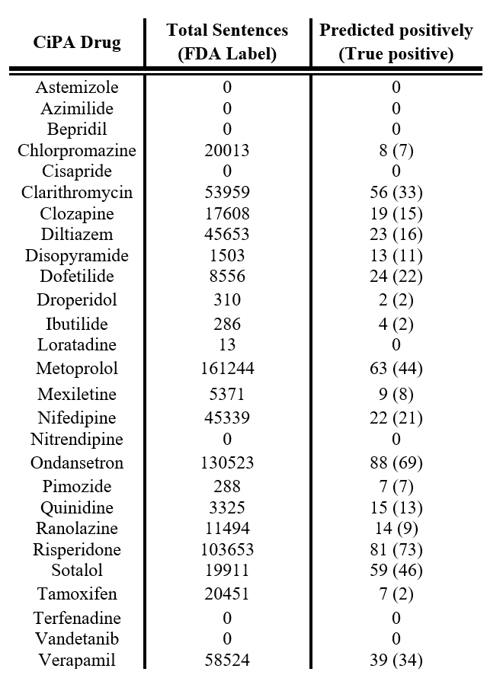
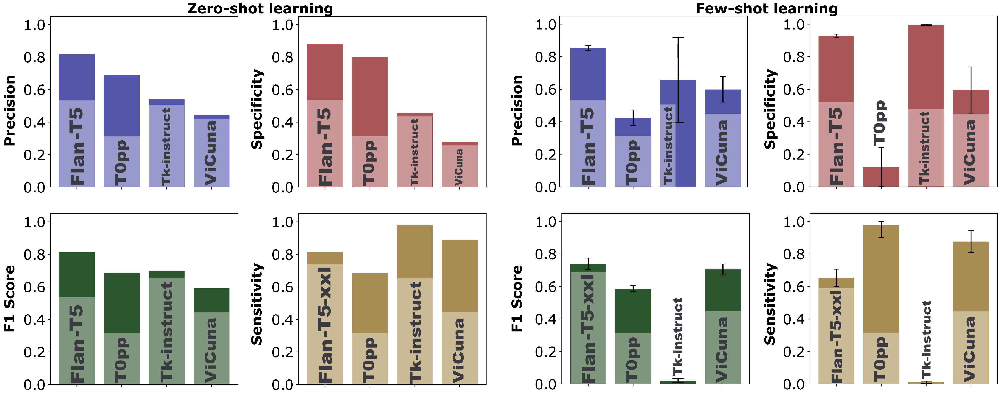
2. Model Evaluation Intrinsic factors affecting drug clinical exposure
Zero and Few-shot learning evaluated by 500 sentences For sentence classification task focused on intrinsic factors that affect drug clinical exposure (198 positive and 302 negative sentences)
From a list of 28 drugs from the Comprehensive in vitro Proarrhythmia Assay (CiPA) Initiative. 708,024 sentences being extracted from the labels
precision rate 78.5%
[1] https://dailymed.nlm.nih.gov/dailymed/fda
Notes:
This slide presents the evaluation results of zero-shot and few-shot learning models on a sentence classification task aimed at identifying intrinsic factors that influence drug clinical exposure. We annotated a dataset of 500 sentences, comprising 198 positive sentences (where patient intrinsic factors affect clinical pharmacokinetics) and 302 negative sentences.
Zero-Shot Learning Evaluation: We tested five models—DeepSeek, Flan-T5, T0pp, Tk-Instruct, and Vicuna—using zero-shot learning.
Flan-T5 and DeepSeek outperformed the others, achieving the highest precision, specificity, and F1 score.
T0pp followed closely, showing competitive performance.
For Few-Shot Learning Evaluation: Flan-T5 and deep-seek once again show as the top performer,. []
To illustrate practical use, we applied this approach to 28 drugs from the Comprehensive in vitro Proarrhythmia Assay (CiPA) initiative, analyzing 700,000 sentences extracted from FDA labels.
The table on the right summarizes the results:
Total sentences indicate the number of sentences extracted per drug.
Predicted positively represents the number of sentences classified as describing intrinsic factors, with true positives shown in parentheses.
The overall precision of this approach was 78.5%.
So, Unlike the fine-tuned BioBERT method, which involves two steps (identifying PK-DDI sentences and classifying object/precipitant drugs), large language models simplify the process to a single step—directly identifying intrinsic factors affecting drug exposure.

Slide 18
2. Question and answer
Flan-T5-XXL
Vicuna-13b-v1.5
T0PP
TK-Instruct
Notes:
For a Fun Comparison: here we presents a comparison of the responses generated by different large language models (LLMs)—Flan-T5-XXL, Vicuna-13b-v1.5, T0pp, and TK-Instruct—to the question: “What is pharmacokinetics?”
Model Responses:
Flan-T5-XXL:
The response defines pharmacokinetics as "a branch of pharmacology that deals with the study of how a drug is absorbed, distributed, and excreted by the body."
The answer is concise and scientifically accurate, providing a solid foundational definition.
Vicuna-13b-v1.5:
The response is more detailed, stating: "Pharmacokinetics (PK) is the study of how a drug is absorbed, distributed, metabolized, and eliminated by the body. It is an important aspect of drug development and plays a crucial role in determining the safety, efficacy, and dosing of a drug."
Additionally, it elaborates on factors influencing pharmacokinetics, such as the route of administration and patient-specific considerations.
This answer is comprehensive, adding depth beyond the basic definition.
T0pp:
Provides a brief yet accurate definition: "Pharmacokinetics (PK) is the study of how drugs are absorbed, distributed, and eliminated from the body."
While precise, it lacks the additional context or elaboration seen in Vicuna-13b-v1.5's response.
TK-Instruct:
The response simply states: "pharmacokinetics."
This answer is incomplete and fails to provide meaningful context or detail.
The comparison illustrates the varying capabilities of LLMs in handling biomedical questions

Slide 19
2. Question and answer
DeepSeek (Qwen)
What is pharmacokinetics?
Analysis
What is the difference between pharmacokinetics and pharmacodynamics?
Please reason step by step.
Okay, so I need to figure out what pharmacokinetics is and then understand the difference between pharmacokinetics and pharmacodynamics. Hmm, I remember hearing these terms in my biology class, but I'm a bit fuzzy on the details. Let me try to break it down.
First, pharmacokinetics. I think it has something to do with how drugs move in the body. Maybe it's about absorption, distribution, metabolism, and excretion? Yeah, that sounds familiar. So, when a drug is administered, it gets absorbed into the bloodstream, then distributed throughout the body, metabolized by the liver or other organs, and then excreted, probably through urine or feces. So pharmacokinetics must be the study of these processes. That makes sense because "kinetics" relates to movement or motion, so it's about how the drug moves through the body.
Now, pharmacodynamics. I think this is about what the drug does once it's in the body. Like, how it affects the cells or organs. So it's more about the drug's effects and how it interacts with the body's systems. For example, if a drug is an antibiotic, pharmacodynamics would explain how it kills bacteria. Or if it's a painkiller, how it interacts with the nervous system to relieve pain.
So, putting it together, pharmacokinetics is about the movement and processing of the drug in the body, while pharmacodynamics is about the drug's effects and interactions. They're both important in understanding how medications work and how to use them effectively and safely.
Wait, let me make sure I'm not mixing them up. Sometimes I confuse the two. Pharmacokinetics is the "what happens to the drug in the body," and pharmacodynamics is the "what the drug does to the body." Yeah, that seems right. So, if a doctor wants to determine the right dosage of a medication, they'd look at pharmacokinetics to see how the body absorbs and metabolizes it. Then, they'd look at pharmacodynamics to see the desired effect, like lowering blood pressure or reducing inflammation.
I wonder if there are any overlaps or if they're completely separate fields. I think they're related because the way a drug moves through the body (pharmacokinetics) affects how it can exert its effects (pharmacodynamics). For example, if a drug isn't absorbed properly, it won't reach the necessary concentration to have an effect, which ties into both areas.
Also, I remember something about bioavailability in pharmacokinetics. Bioavailability refers to how much of the drug actually reaches the systemic circulation. If a drug is taken orally, some of it might be metabolized in the liver before it even gets into the bloodstream, which would affect its bioavailability. This is crucial because it determines the effective concentration of the drug in the body.
In pharmacodynamics, concepts like efficacy and potency come into play. Efficacy is the maximum effect a drug can produce, while potency refers to the concentration needed to achieve a certain effect. So, a drug with high efficacy can produce a strong effect, but if it's not potent, you might need a larger dose to reach that effect.
Another thing I'm thinking about is the time course of drug action. Pharmacokinetics deals with how quickly a drug is absorbed and how long it stays in the system, which affects how often it needs to be administered. Pharmacodynamics looks at how quickly the drug starts working and how long the effects last. Together, they help in designing dosing regimens that are both effective and minimize side effects.
I also recall that pharmacokinetics can be influenced by various factors like age, weight, liver and kidney function, and even genetics. For instance, someone with impaired kidney function might excrete drugs more slowly, leading to higher concentrations in the body. This would be a pharmacokinetic consideration. On the other hand, pharmacodynamics can be influenced by factors like tolerance or drug resistance, where the body becomes less responsive to the drug's effects over time.
So, in summary, pharmacokinetics is about the body's handling of the drug—absorption, distribution, metabolism, excretion—while pharmacodynamics is about the drug's handling of the body—its effects and interactions. Understanding both is essential for developing safe and effective medications and determining the appropriate dosages and administration routes.
I think I've got a good grasp now. Pharmacokinetics is the "what happens to the drug," and pharmacodynamics is the "what the drug does." They're two sides of the same coin in pharmacology, each focusing on different aspects of how drugs interact with the body.
**Final Answer**
Pharmacokinetics is the study of how a drug moves through the body, including absorption, distribution, metabolism, and excretion. Pharmacodynamics, on the other hand, focuses on the drug's effects and interactions within the body. The key difference is that pharmacokinetics examines what happens to the drug in the body, while pharmacodynamics examines what the drug does to the body.
Notes:
For DeepSeek, as you can see, the response is similar to ChatGPT-4. It includes analysis and generates additional follow-up questions, leading to a stronger and more insightful answer.

Slide 20
Summary
Prior Study
For any task such as identify the clinical exposure, change due to PK DDI from a sentence there are naturally three steps:
Obtain annotated dataset to fine-tune the pre-trained language model.
Identify sentences that carry DDI information in the PK category.
Identify the precipitant and objects drugs in those sentences.
Second Study
Using large language model make it feasible to extract clinical pharmacology information.
We first test it by extracting PK-DDI sentences using five well known LLMs (DeepSeek, Tk-Instruct, Vicuna, T0pp, and Flan-T5-XXL)
Apply a randomly new task (patients' intrinsic factors) without fine-tuning.
Both zero-shot and few-shot learning provided excellent performance.
These models stand out because they don’t require fine-tuning, making them easier to implement compared to the fine-tuned BioBERT model.
Our results demonstrate the feasibility of implementing a ChatGPT-like model within the FDA network with secure local deployment.
Notes:
In our prior study, we focused on identifing clinical exposure changes due to pharmacokinetic drug-drug interactions (PK-DDIs). This process involved three key steps:
Obtain an annotated dataset to fine-tune a pre-trained language model.
Identify sentences containing Drug-drug Interaction information categorized as PK-DDI.
Extract precipitant and object drugs from those sentences identified as PK-DDI. []
The second study showcased the potential of large language models (LLMs) to extract clinical pharmacology information without requiring fine-tuning. Here's how the study was conducted:
PK-DDI Sentence Classification: We evaluated the performance of five prominent LLMs—DeepSeek, Tk-Instruct, Vicuna, T0pp, and Flan-T5-XXL—on the task of classifying PK-DDI sentences.
Intrinsic Factors Analysis: The models were further tested on a novel task: identifying intrinsic factors such as age, weight, and genetics that influence drug clinical exposure.
Zero-Shot and Few-Shot Learning: Both zero-shot and few-shot learning approaches delivered outstanding performance, demonstrating the adaptability of these models.
What sets these models apart is their ability to perform effectively without fine-tuning, making them significantly easier to implement and use compared to fine-tuned models like BioBERT.
Our findings highlight the posibility of deploying a Chatbot-like model within a secure local environment, providing a reliable and efficient solution for extracting regulatory data and advancing clinical pharmacology research.

Slide 21
Acknowledgment
Zhihua Li
John Mann
Shilpa Chakravartula
Anik Chaturbedi
Fnu Affan
Alexander Galluppi
Nigar Karimil
Ji Young Kim
Yue Han

Slide 22
Thank you!

